Slide 1
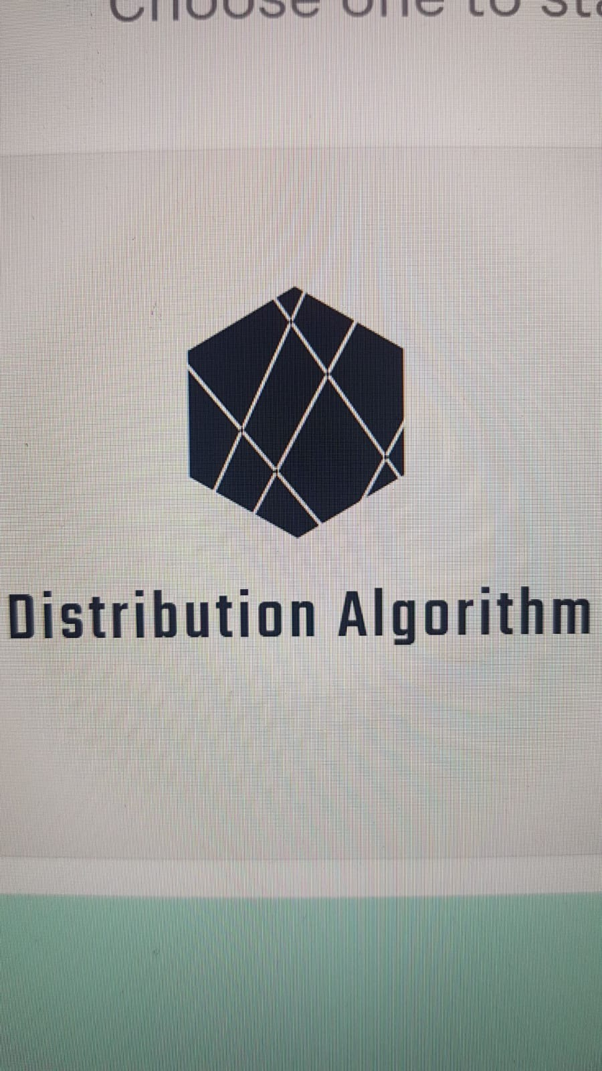
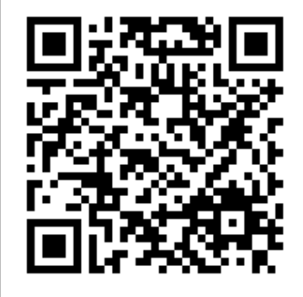
Software Development Project Project Name - Distribution Algorithm
Servers - Team Leader: Daniel Abergil
Eliyahu Satat, Nahshon Satat, Netanel Ben Issachar, Elyashiv deri, Jordan Gaon
Instructors - Dr. Arel Segal Halevi
Contribution project:
Distribution Algorithm Project - Implementing the algorithm and making it easy to distribute objects and resources between people fairly and without jealousy.
2. Introduction Creating an accessible site and server in Python language by selecting the realization algorithm for fair distribution and without the envy of discrete resources / objects with a minimum number of shares.
3. Methods/algorithms/Alternatives or Design Considerations Methods - Distributing the project team into sub-teams Each team is responsible for something specific and at the end of unifying and connecting all the teams for one purpose.
Algorithm - Our algorithm relies on several types of economic algorithms to find the "formula" best suited to jealous fair distribution.
Problem Description - Finding a Distribution Algorithm That Can Generate a Generic Solution in the Highest and Best
4. Selected Approach We have chosen to work with the method of reducing the possibility as much as possible until we reach the desired result, for example: a smart whole search and downloading / reducing options in advance so that we can return an answer at a reasonable time.
5. Solution Description (Algorithms, Modulation, Patterns, Infrastructure, UI, Functionality) The algorithm team was able to create several versions of the algorithms so that in the final version we were able to improve the running time of the algorithm 20 times the initial version with a pre-reduction of
The Algorithms uses the cvxpy library to solve the curvature problem - to solve the problem and graphs.
Server team - managed to pick up a server that knows how to use the algorithm and get a large number of multi-hassle inquiries, after the user's request for distribution is actually directed to Algiers and with NGINX and UWSGI algorithm knows to choose the most suitable "formula". The results of the distribution are given in two ways depending on the number of participants - in case of relatively small number of participants the answer appears immediately on the screen, in case of multiple participants the result takes more time and is sent to the e-mail address.
The site team has set up a user-designed and user-friendly website that helps anyone who wants to use the algorithm to run it in a convenient and understandable way.

